Slide 1
Quick Test Professional
Testing Process

Slide 2
Testing Process
Creating Tests
Running Tests
Analyzing Test Results

Slide 3
Creating Tests
You create a test by recording the typical processes that users perform. QuickTest records each step you perform and generates a test tree.
By default, each test includes a single action, but can include multiple actions.

Slide 4
How?
When you perform an operation on your application
while recording a test, QuickTest:
  Identifies the QuickTest test object class
  Reads the current value of the object’s properties in your application and stores the list of properties and values with the test object.
  Chooses a unique logical name for the object, generally using the value of one of its prominent properties.
  records the operation that you performed on the object

Slide 5
Recording Modes
Two Recording Modes:
        Standard Recording Mode
        Low-Level Recording Mode

Slide 6
Recording Modes
Standard Recording Mode
records the objects in your application and the operations performed on them.
Low-Level Recording Mode
If you want to record mouse clicks and keyboard input with the exact x- and y-coordinates
Note:
By default, QuickTest records in the Standard Recording Mode

Slide 7
Sample Code
Standard Recording Mode
Dialog("Login").WinEdit("Agent Name:").Set "test“
Dialog("Login").WinEdit("Password:").SetSecure "4158f4162e12127c055c26“
Dialog("Login").WinButton("OK").Click
Low-Level Recording Mode
Window("Login").WinObject("Agent Name:").Type "test"
Window("Login").WinObject("Password:").Click 88,14
Window("Login").WinObject("Password:").Type "mercury"
Window("Login").WinObject("OK").Click 42,12
Note:
In QuickTest, test scripts are composed of statements coded in Microsoft's programming language, VBScript.

Slide 8
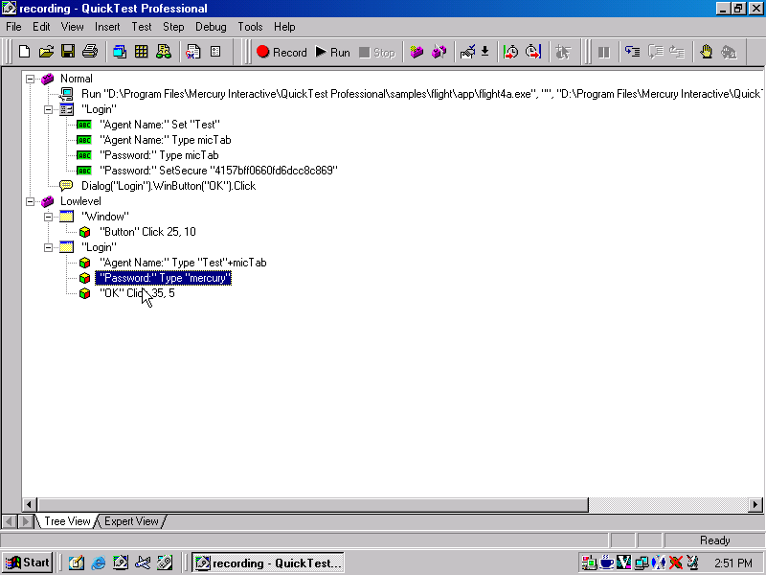
Standard
Low-Level

Slide 9
About Object Repository

Slide 10
How QuickTest identifies objects
When you create a test by recording,QuickTest learns the properties of testobjects and are stored in Object repository. When the test runs, QuickTest searches for the object that matches the description it learned.
There are two types of object repositories:
Shared object repository : For multiple tests.
Action object repository : Separate repository for each action.Otherwise called as Object repository Per Action

Slide 11
Setting Object Repository Mode
For Default mode:
  Tools => Options => Resources Tab.
For a Test :
  Test => Settings => Resources Tab
Object Repository Files will be saved with an extension .tsr

Slide 12
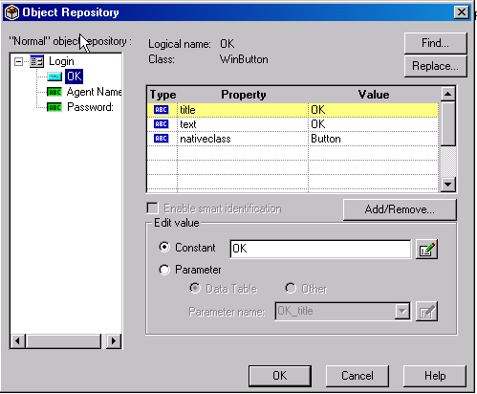
Object Repository

Slide 13
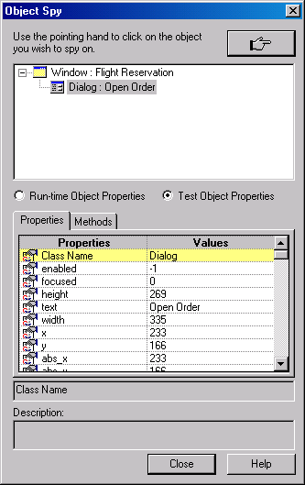
Viewing Object Properties Using the Object Spy
Tools = > Object Spy

